Slide 1
A study to idntify best areas to live in Tornto
By Moataz

Slide 2
How to make know it with minimum data
Families like to select between schools and be near them when relocating to a new area.
As we can get areas and number schools in each, then we can make a study according to them

Slide 3
Data Acquisition and cleaning
We are using wikipedia which provides us with potal code names of all areas in Toronto
Using google service or a file that converts areas to location: longitude and latitude
Using Foursquare service to get number of schools around each area and we can get the ratings too
We will use only areas that have valid nam area in the wikipedia data.

Slide 4
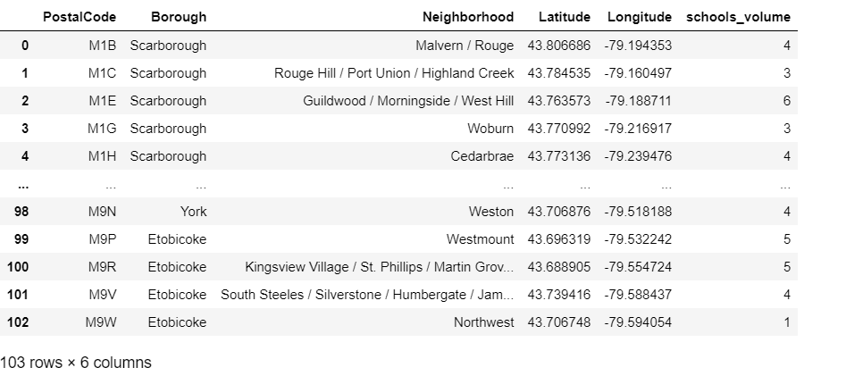
Data after cleaning

Slide 5
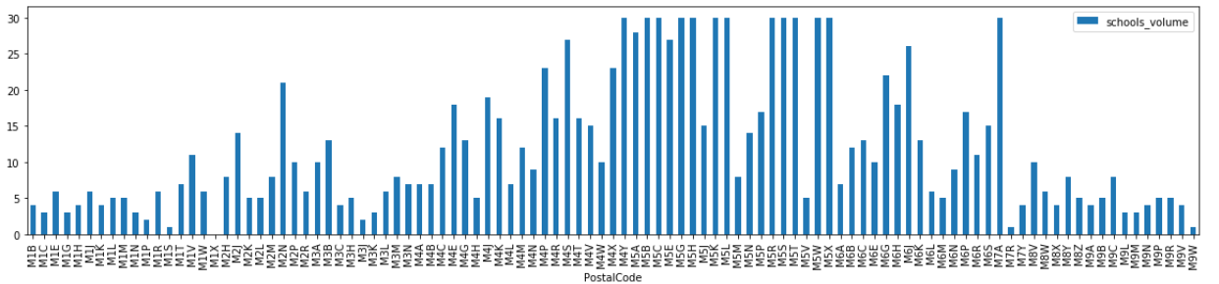
School distribution among areas

Slide 6
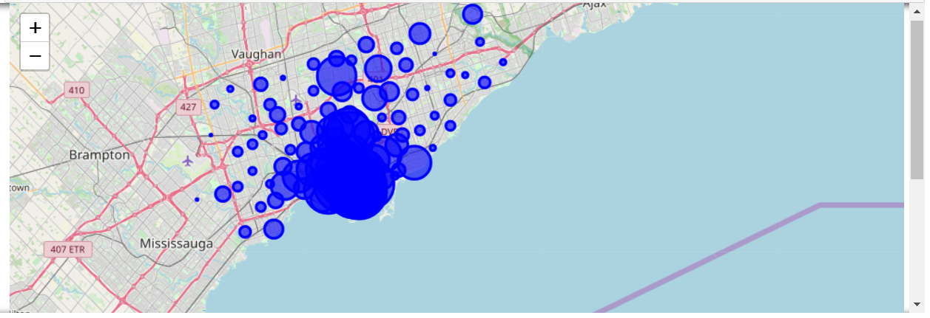
School distribution among areas

Slide 7
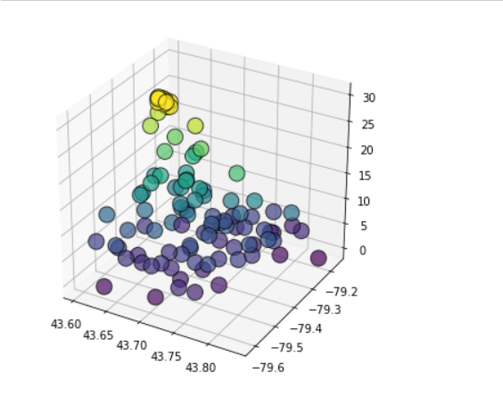
Scatter of schools and location

Slide 8
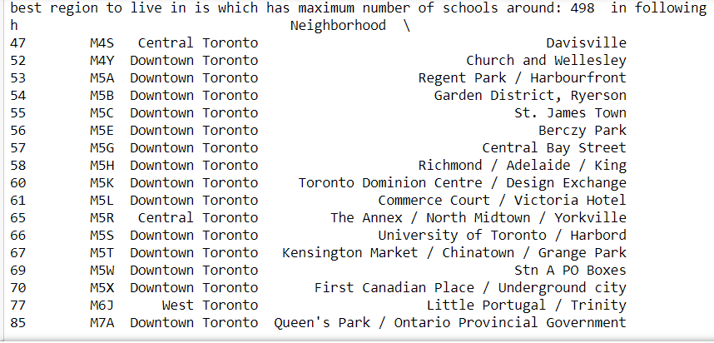
Results and Conclusion

Slide 9
Future
Add population feature
Add more
acccomodation
features
Add ratings

